Slide 1
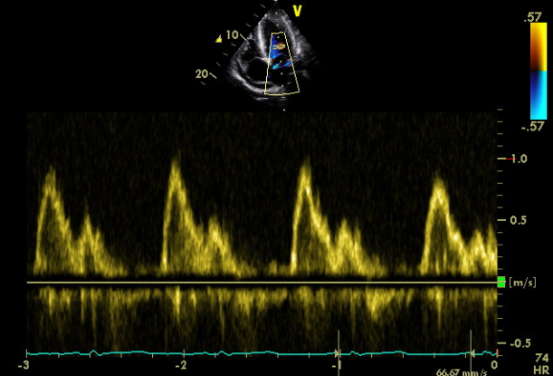
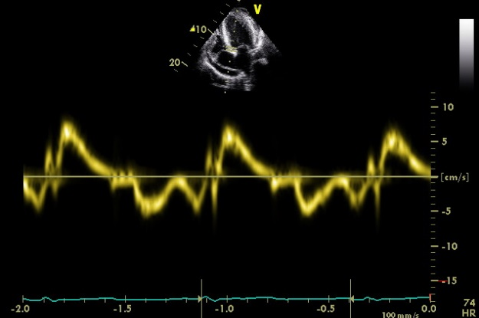
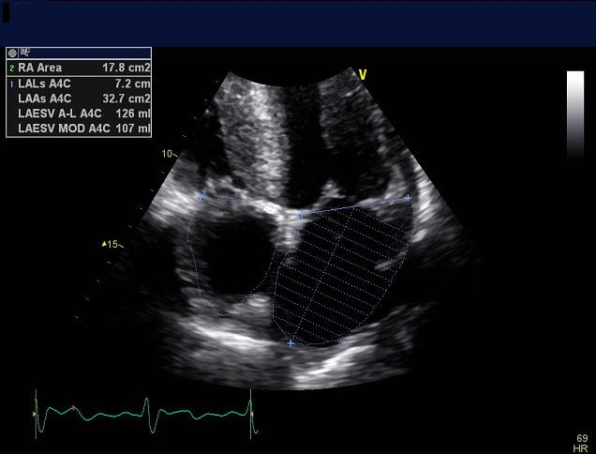
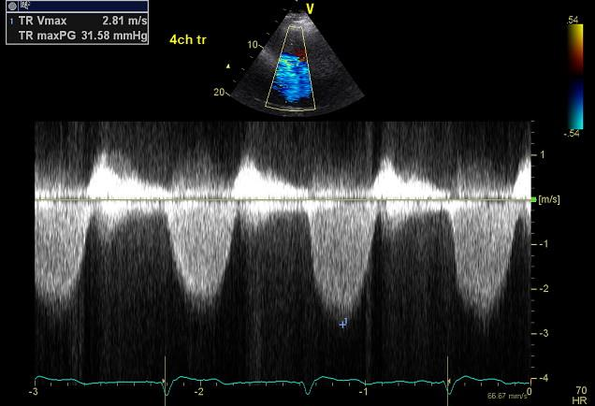
  Practical Application of Diastolic Function Assessment
  ASE/EACVI Diastology Guidelines
Tips & Tricks in Echo
Allan L Klein M.D.
Director, Center of Pericardial Diseases
Professor of Medicine
Heart and Vascular Institute
Cleveland Clinic
Past- President, ASE

Slide 2
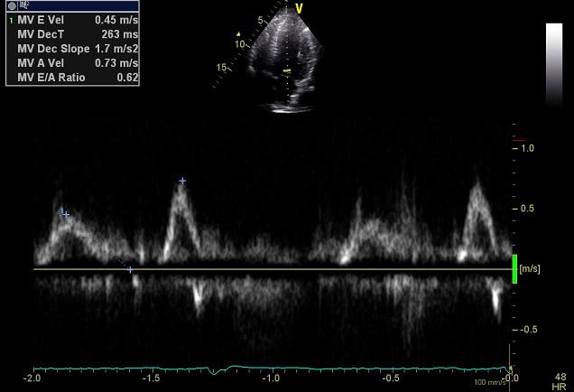
  Practical Application of Diastolic Function Assessment
  ASE Diastology Guidelines Update
Introduction
2016 guidelines
Echo parameters
Myocardial pathology
Supplementary parameters
0718-102

Slide 3
PRESIDENT’S MESSAGE
0718-104

Slide 4
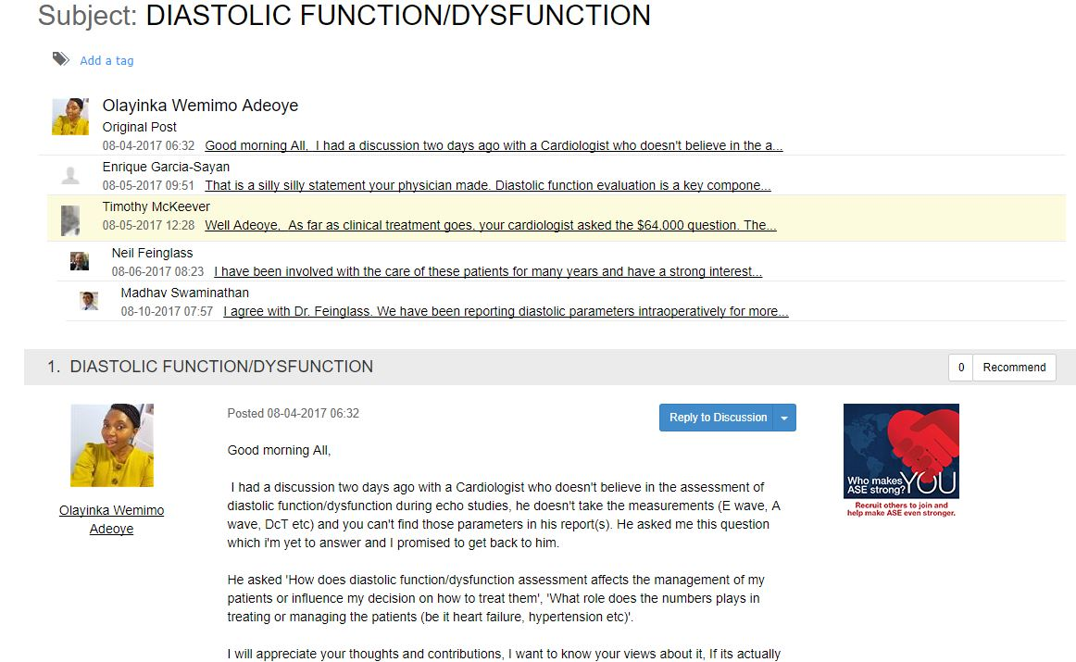
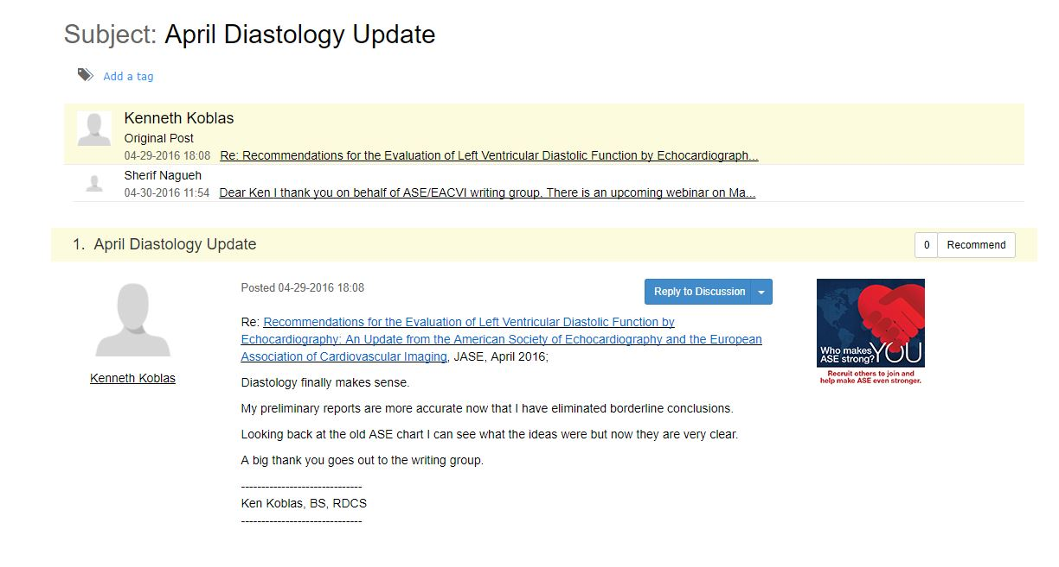
@ASE Connect
Ongoing Dialogue
“I had a discussion with a cardiologist
who doesn’t believe in the assessment
of diastolic function”
“Diastology finally makes sense..
A big thanks to the writing group”
0718-109

Slide 5
Epidemic of Indeterminate DF evaluations

Slide 6
  Practical Application of Diastolic Function Assessment
  ASE Diastology Guidelines Update
Introduction
2016 guidelines
Echo parameters
Myocardial pathology
Supplementary parameters
0718-102

Slide 7
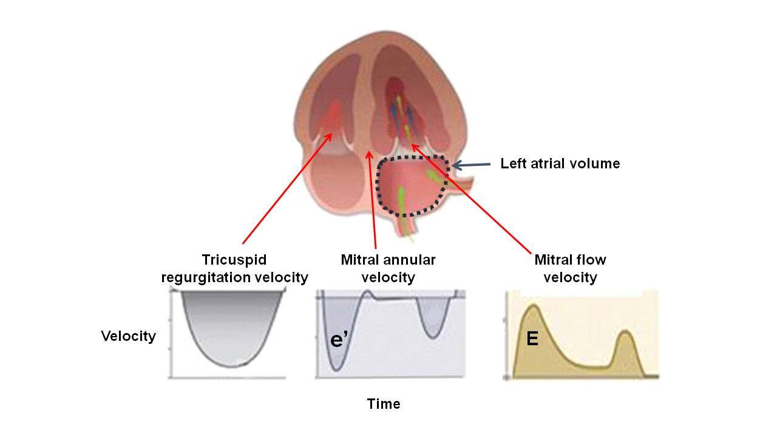
Key Diastology Parameters
Nagueh et al. J Am Soc Echocardiogr 2016;29:277-314
0718-142

Slide 8
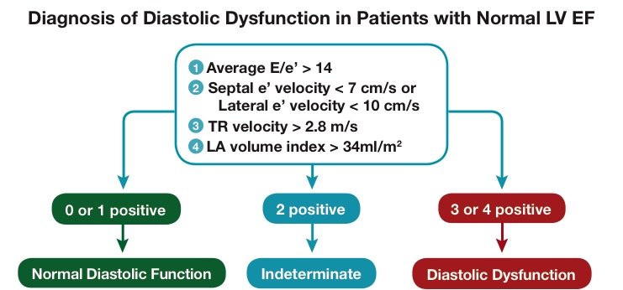
Criteria for Diagnosis of LV
Diastolic Dysfunction
(Algorithm 1)
Nagueh et al. J Am Soc Echocardiogr 2016;29:277-314
0718-144

Slide 9
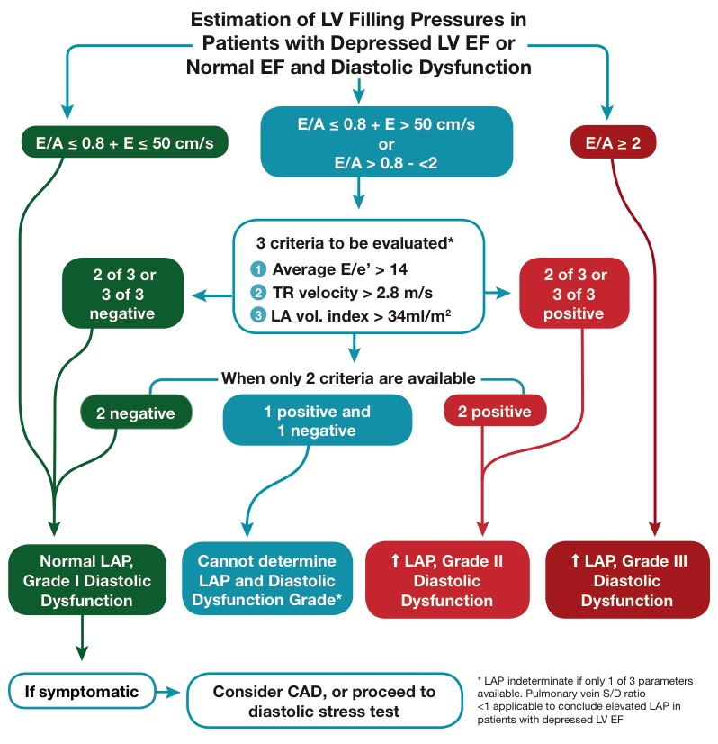
Estimation of LV Filling Pressures and Grading DF
(Algorithm 2)
Nagueh et al. J Am Soc Echocardiogr 2016;29:277-314
0718-145

Slide 10
  Practical Application of Diastolic Function Assessment
  ASE Diastology Guidelines Update
Introduction
2016 guidelines
Echo parameters
Myocardial pathology
Supplementary parameters
0718-102

Slide 11
Mitral Inflow
Measurements
Appleton et al., J Am Soc Echo 1997;10:271-91
0718-116

Slide 12
MV Inflow PW Doppler
Apical 4 chamber view
Color flow imaging for optimal alignment
SV size 1 – 3 mm placed at leaflet tips
Optimize spectral gain and wall filters
Sweep speed measure at 50-100 mm/s

Slide 13
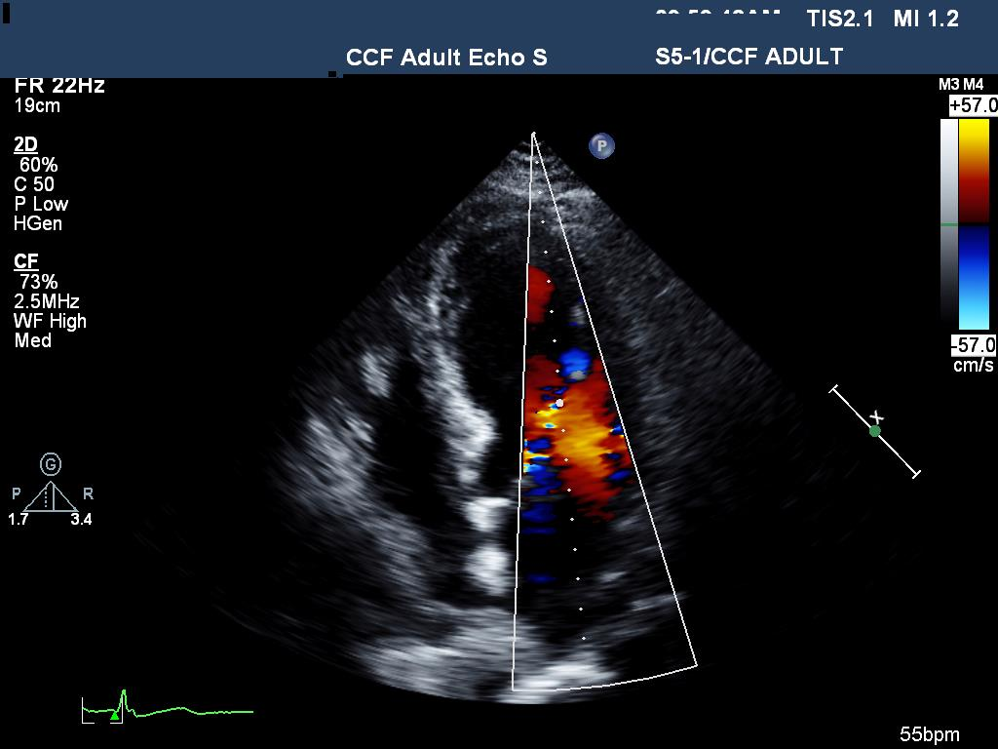
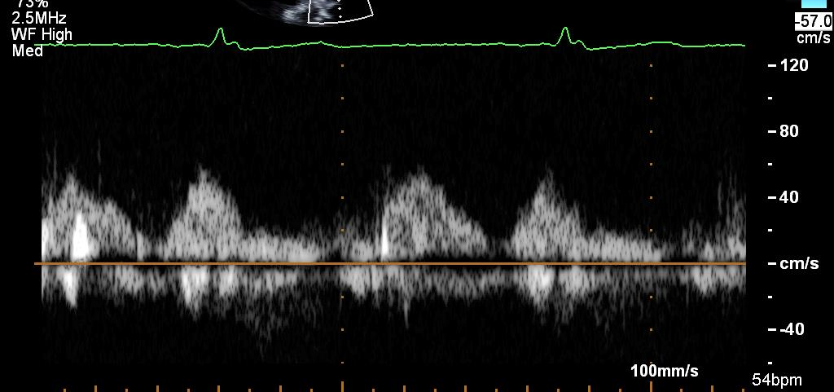
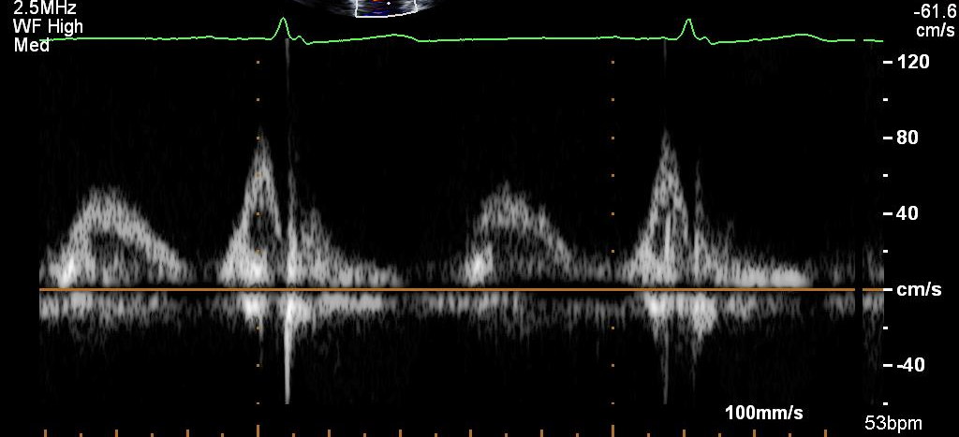
MV Inflow PW SV Placement
Incorrect -towards Apex
Correct - Leaflet Tips

Slide 14
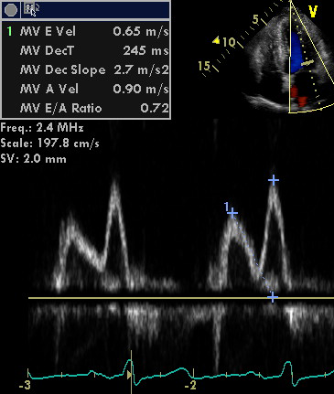
MV Inflow PW Measurements
Measurements: peak E–wave, A–wave, E/A ratio, deceleration time
Limitations: sinus tachycardia, conduction system disease, arrhythmias, eccentric AI
Notes:
Produces fused e/a

Slide 15

Tissue Doppler Imaging
s’
e’
a’
0718-125

Slide 16
PW DTI of Mitral Annular Velocities
Apical 4 chamber
SV (5–10 mm) placed at or within 1 cm of mitral leaflet insertion sites
Optimize gain/filter settings and minimize the angle of incidence (<20 degrees)
Velocity scale 20 cm/s above below baseline, sweep speed 50 to 100 mm/s

Slide 17
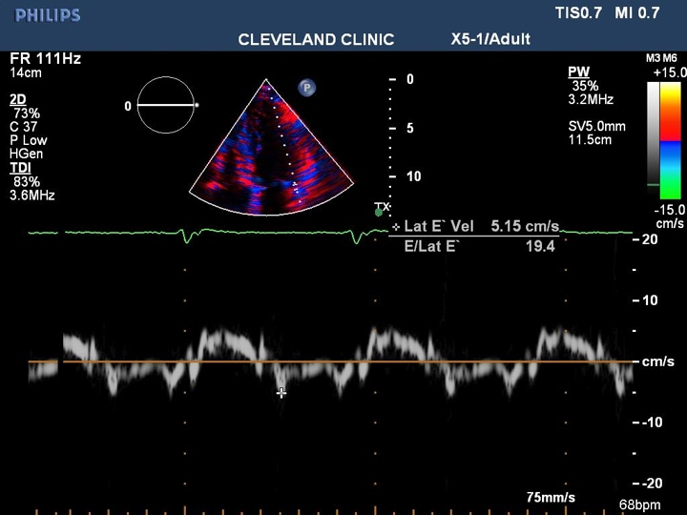
PW DTI of Mitral Annular Velocities
Measure early (e’) diastolic velocities
Average septal and lateral velocities, calculate E/e’
Limitations: e’ reduced with MV surgical rings (repair), prosthetic valves, annular calcification and mitral stenosis, e’ increased with > 2+MR

Slide 18
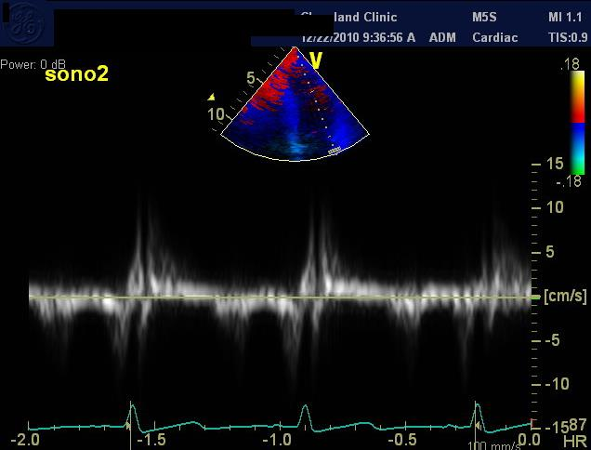
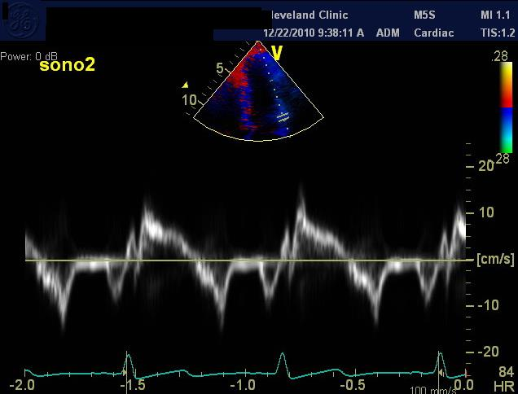
PW DTI SV Placement
TDI e’ ?
SV size 5 – 10 mm
TDI e’ 5
Notes:
Ap4, SV 5- 10 mm., placed on annulus, line up parallel with wall, average septal and lateral (usually higher), ultrasound system presents for wall filter and lowest signal gain, spectral waveform should be sharp with no signal spikess, feathering ghosting, peak modal velocity in early diastole at leading edge of spectral waveform, point out isovolumic contraction, systole, mention isovolumic relax ,

Slide 19
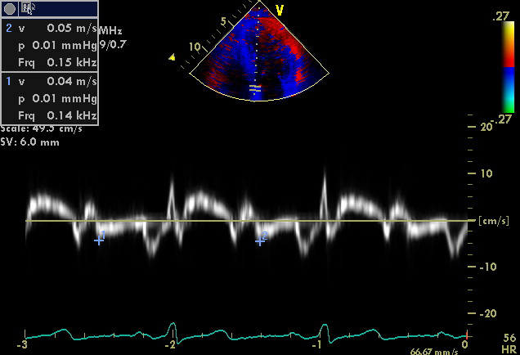
Common mistake – don’t measure the first downward deflection
IVC
s’
IVR
IVC
IVR
e’
a’

Slide 20
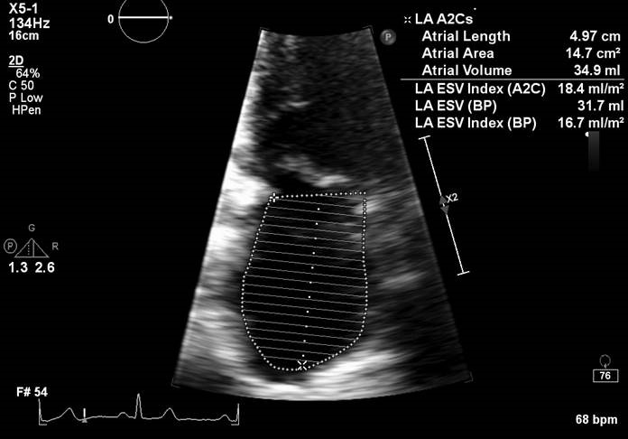
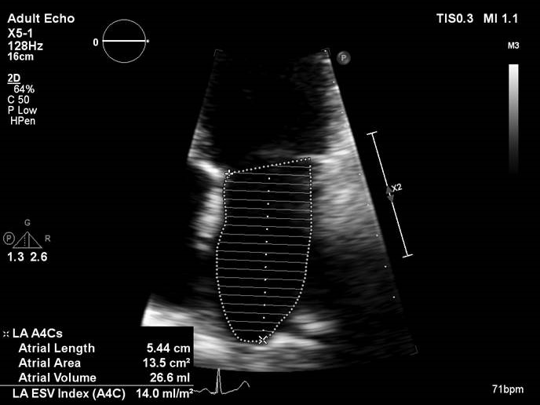
LA Volume Index
LA volume measured using:
  Simpson’s Method
  Area-Length Method
V=8A₁A₂/3пL
LAVI = LAV/Body Surface Area
A 2 chamber view
A 4 chamber view
0718-131

Slide 21
LA Acquisition
LV and LA frequently lie in different planes
Avoid foreshortening LA
  Base of the atrium should be at its largest size
  LA length should be maximized

Slide 22
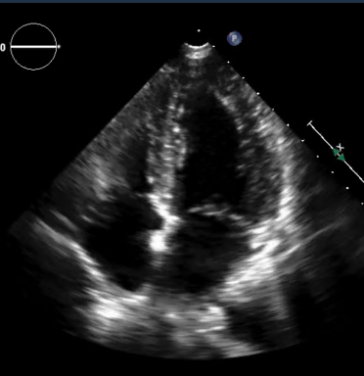
LV and LA frequently lie in different planes

Slide 23
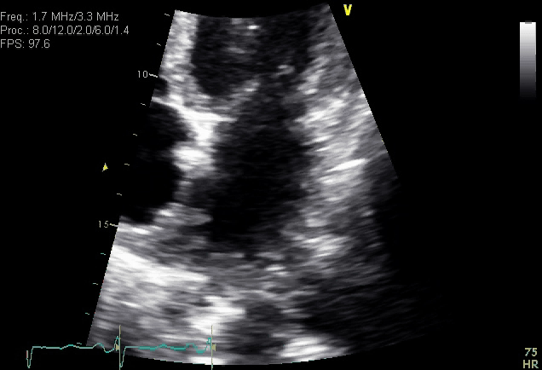
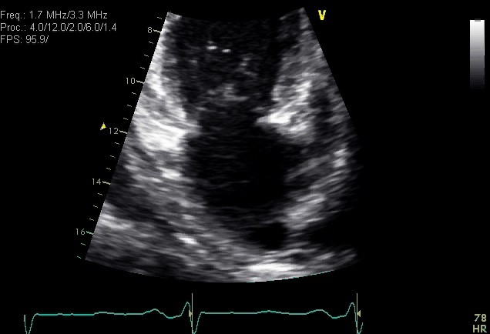
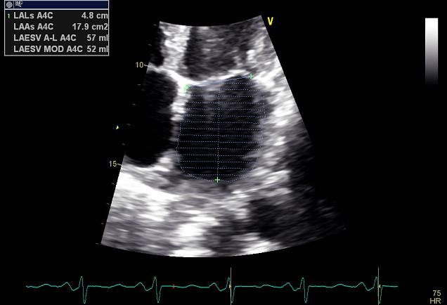
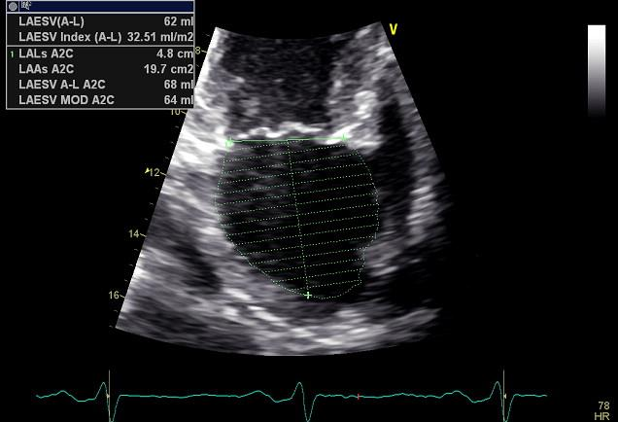
LA Volume Measurement
LA Volume Index (mL/BSA)~ 32.4 ml/m2
Notes:
1-2 frames before MV opening, draw a line from one annulus to the opposite side. Biplane method of disks

Slide 24
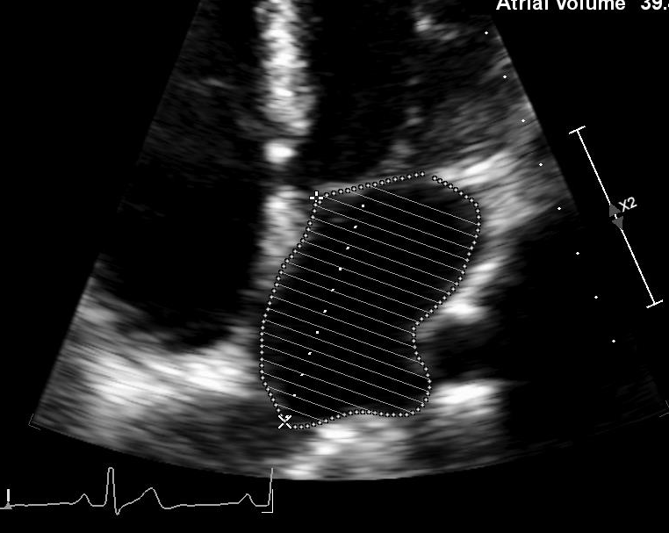
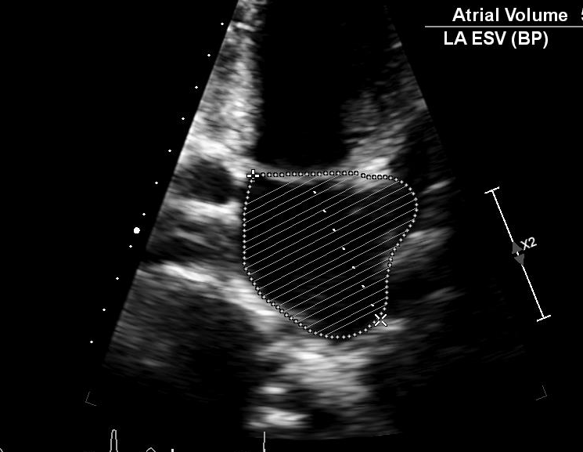
LA Measurement Tips
Do not include LA appendage or pulmonary veins in LA tracings from A4C or A2C views
The long-axis lengths should be within 5 mm of each other

Slide 25
Peak TR Velocity
Diligence is necessary, scan from multiple windows
Agitated saline contrast is recommended if signal-to-noise ratio is poor
Measure full, well-defined envelopes
Consider PR signal for mean PAP

Slide 26
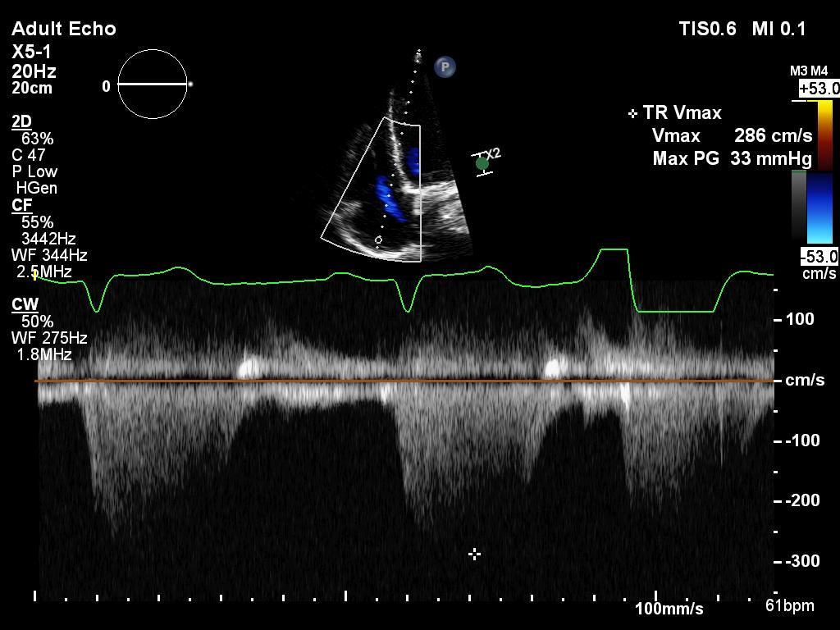
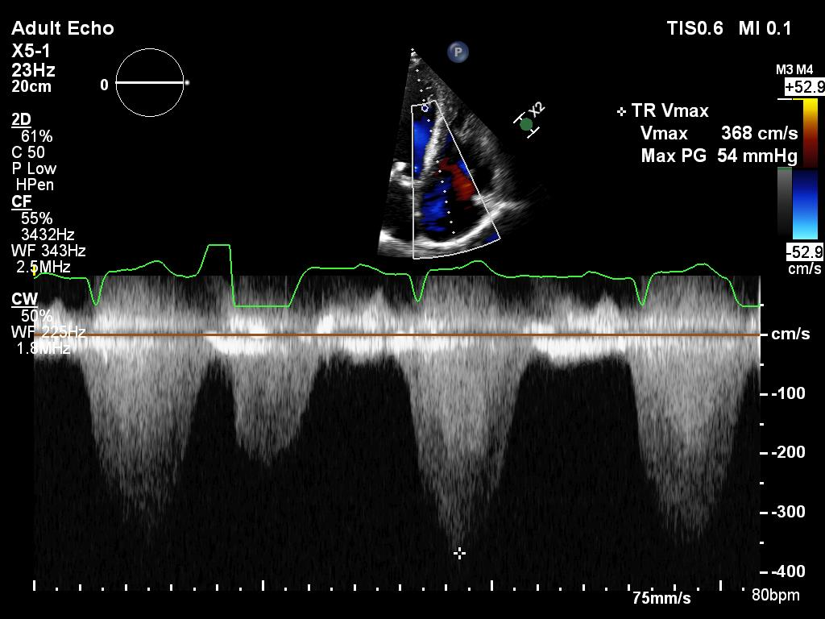
Peak TR Velocity
Saline Enhanced
Notes:
Measure full, well-defined envelopes

Slide 27
  Practical Application of Diastolic Function Assessment
  ASE Diastology Guidelines Update
Introduction
2016 guidelines
Echo parameters
Myocardial pathology
Supplementary parameters
0718-102

Slide 28
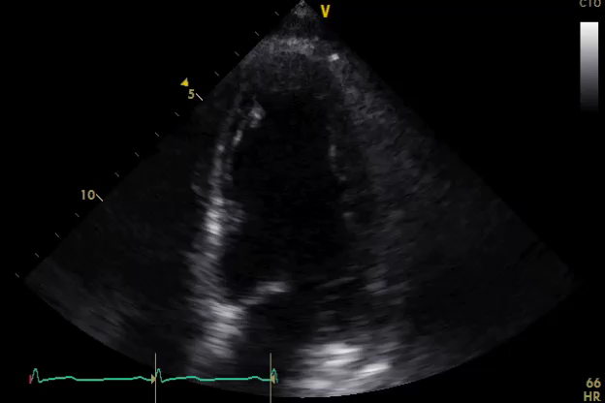
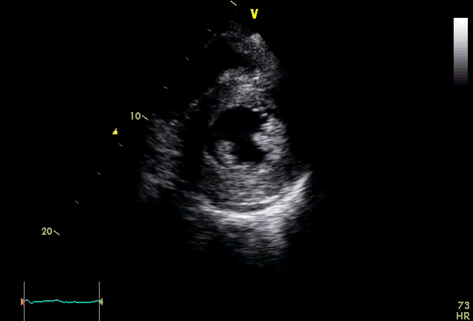
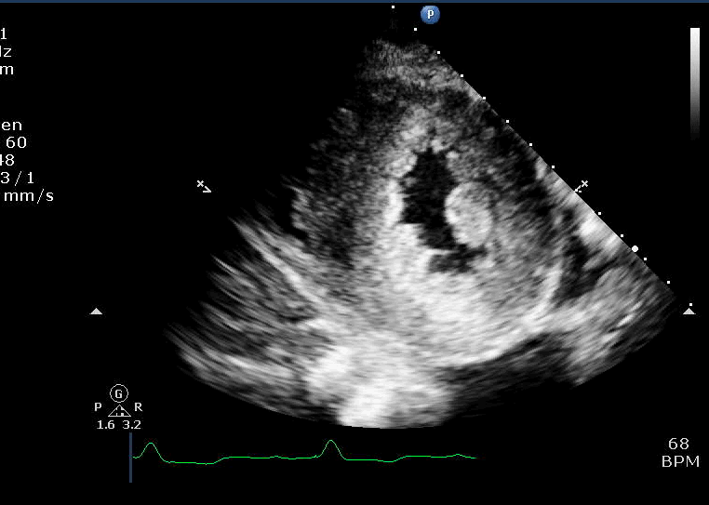
How Do You Determine Diastolic Dysfunction
Myocardial Pathology ( Algorithm 2)
Extensive cardiac history
Known CV disease as coronary artery disease
  Wall motion
Pathologic LVH
Hypertensive CV Disease
Cardiomyopathy
Established Diagnosis of HFpEF
If 3/4 positive parameters from Algorithm 1
EF reduced
Specific Doppler signals
0718-146

Slide 29
  Practical Application of Diastolic Function Assessment
  ASE Diastology Guidelines Update
Introduction
2016 guidelines
Echo parameters
Myocardial pathology
Supplementary parameters
0718-102

Slide 30
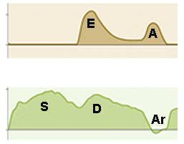
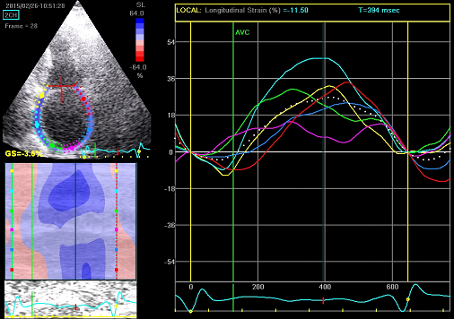
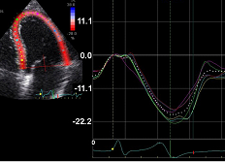
Supplementary Measures
A duration
Mitral E-deceleration time <150 ms
Ar - A duration difference > 30 ms
Pulmonary venous S/D ratio <1
Ar duration
LV global longitudinal strain
Left atrial reservoir strain
Normal > 18%
Normal > 20%?
Smiseth O. Journal of Echo 2018;16:55-64
0718-151

Slide 31
Special Populations
Atrial Fibrillation
Hypertrophic Cardiomyopathy
Restrictive Cardiomyopathy
Sinus Tachycardia
Bundle Branch Block
Moderate to Severe MR
Mitral Stenosis
Severe Aortic Insufficiency
Heart Transplant Patients
Cardiac causes of Pulmonary Hypertension
Notes:
Certain conditions modify the relationship between left ventricular filling pressures indices of diastolic function.
Can limit the utility and accuracy of some parameters in the updated ASE Diastology algorithm

Slide 32
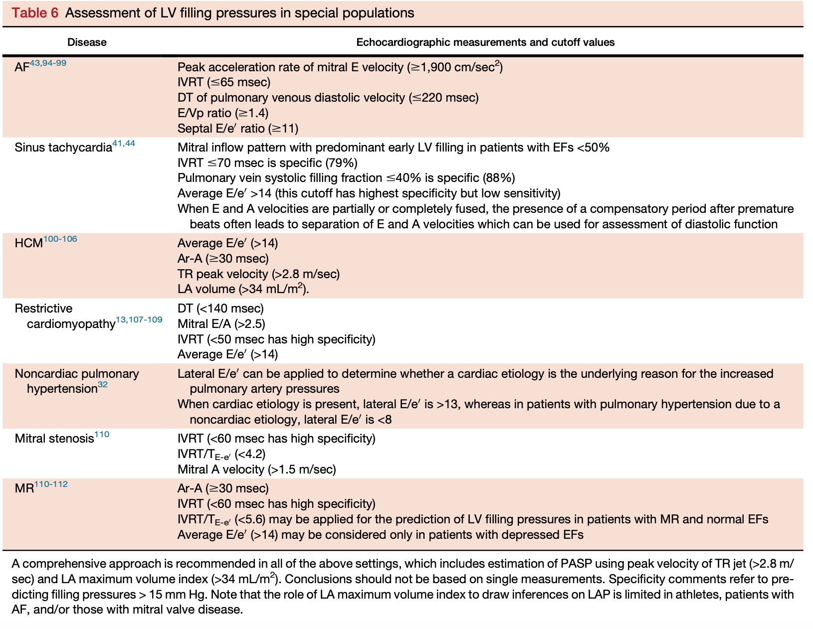
Nagueh et al, JASE 2016;277-314.
Notes:
**COMPREHENSIVE APPROACH IN ALL OF THE ABOVE SETTINGS, CONCLUSIONS SHOULDN’T BE BASED ON JUST A SINGLE MEASUREMENT.

Slide 33
  Practical Application of Diastolic Function Assessment
  ASE Diastology Guidelines Update
  Take Home Points
The “In” Parameters are Mitral E/A, TDI, LAVI and RVSP
Important to consider
Clinical setting
2D findings (LVH, LA volumes, LV EF and volumes)
Evaluate technical quality of acquired signals
Who gets you into algorithm 2?
Supplementary parameters including LV and LA strain can help reclassify indeterminate DF
Report: LV filling pressures and grade of diastolic dysfunction
0718-1108

Slide 35


Thank you
kleina@ccf.org
@AllanLKleinMD1

